Slide 1

Sky gazer

Slide 2
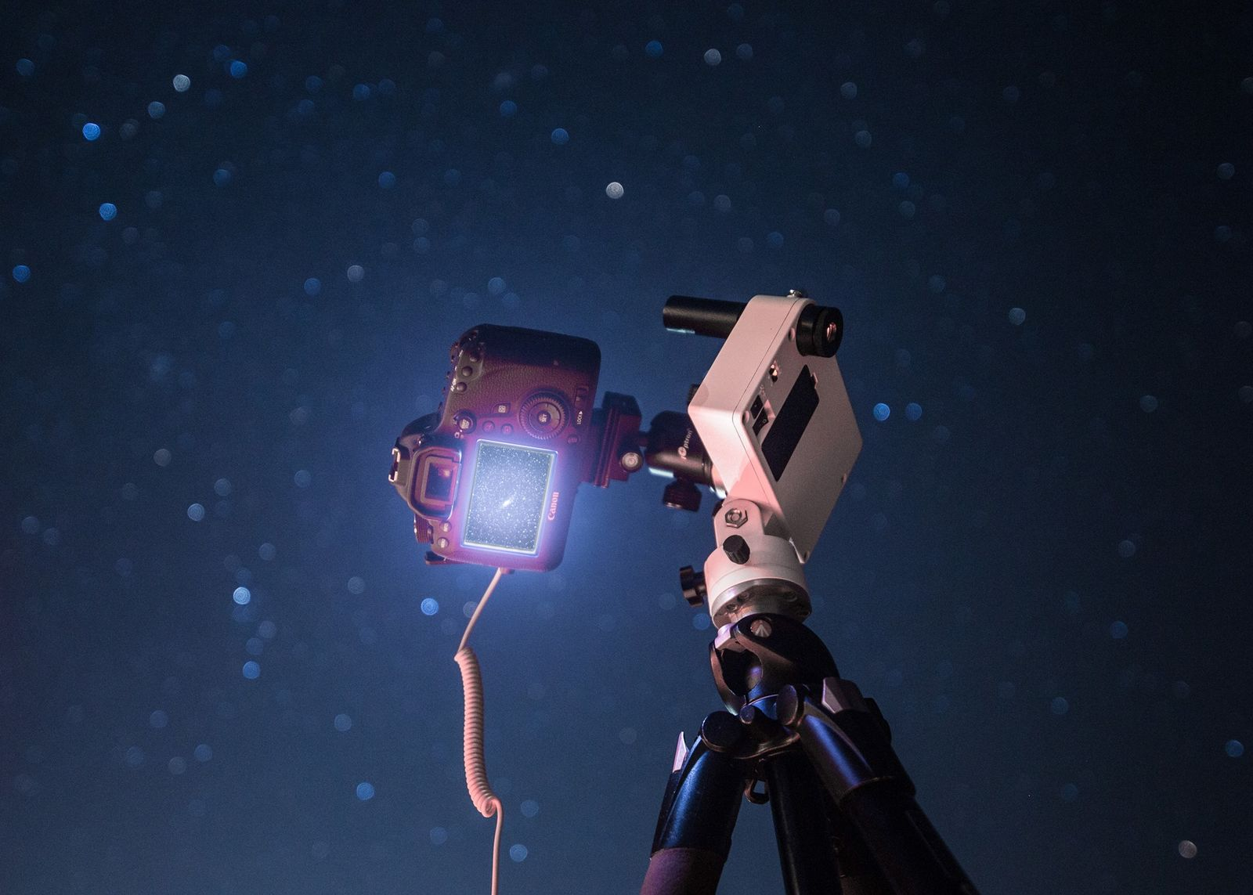
Sky gazer
- Observing celestial objects in the night sky
- Includes stars, planets, moon, comets, and constellations
- Helps understand the universe

Slide 3
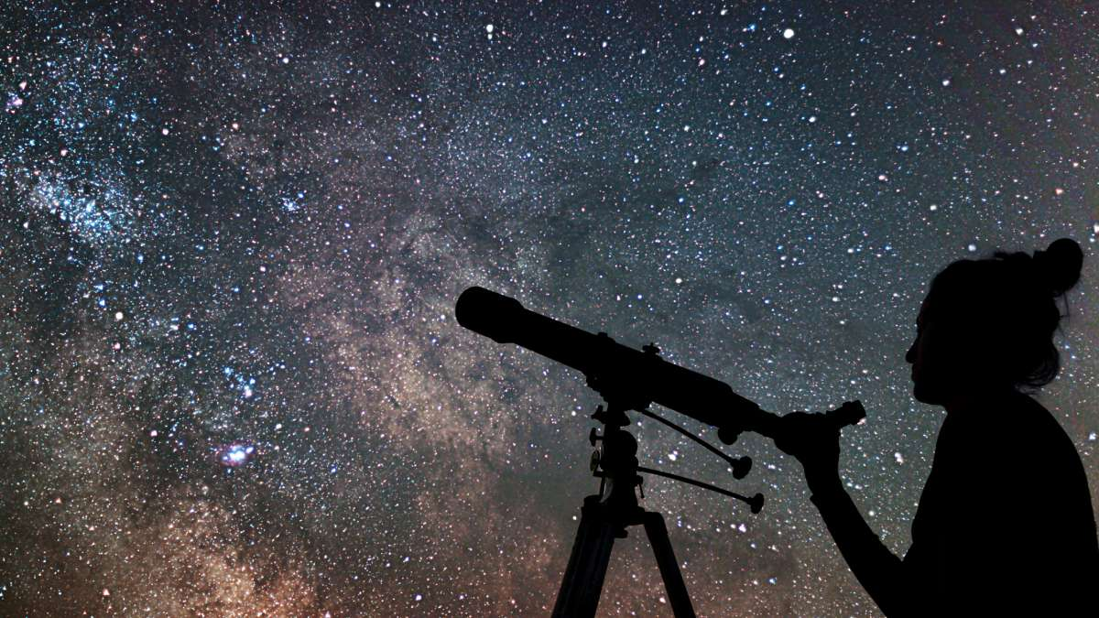
THE POWER OF COMMUNICATION
Sky gazer

Slide 4
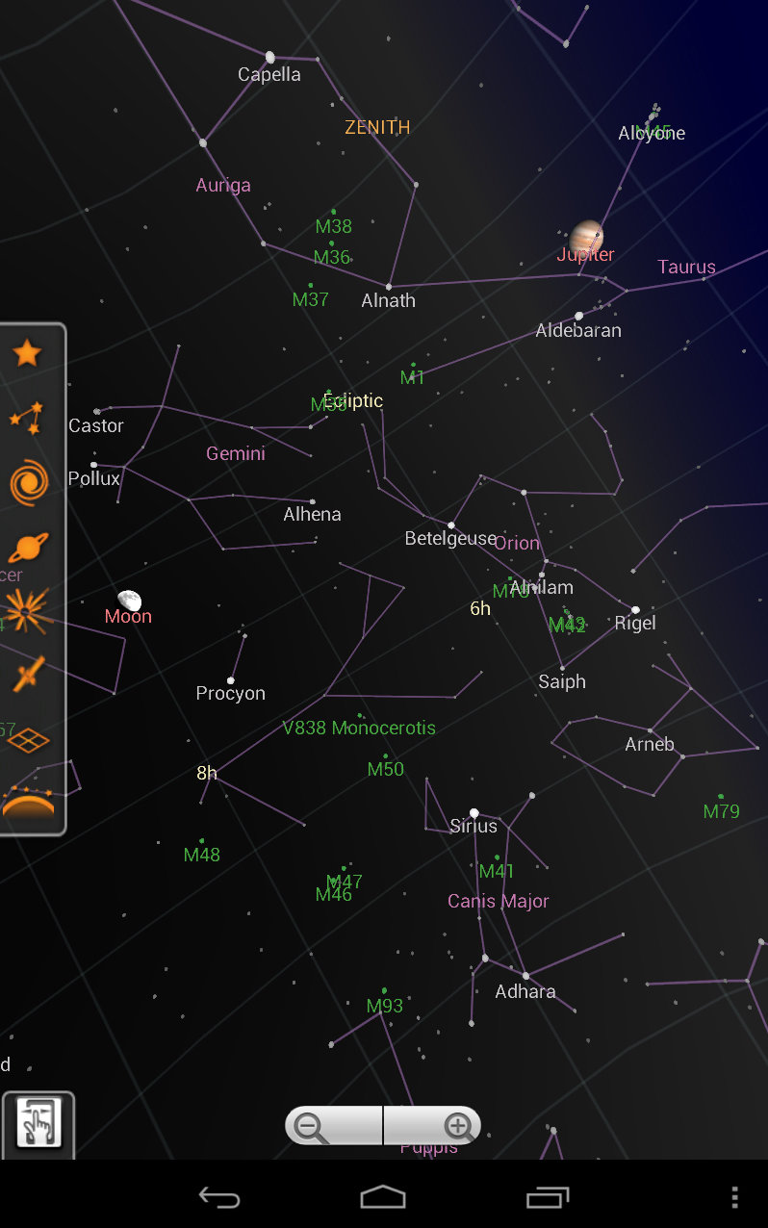
Features
Real‑time sky maps
Telescope integration
Educational resources
Community sharing

Slide 5
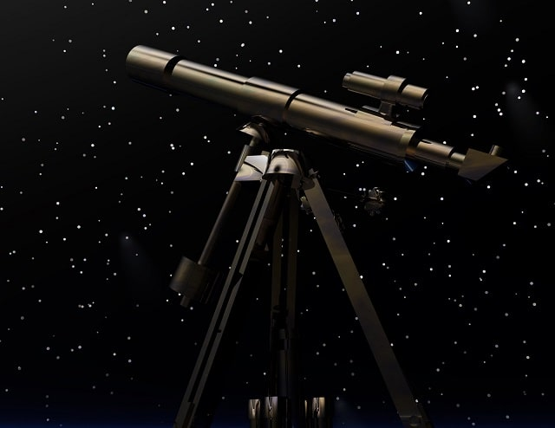
Essential Tools
- Naked eyes for beginners
- Binoculars for enhanced viewing
- Telescopes for deep-sky objects
- Mobile apps like SkyView, Stellarium

Slide 6
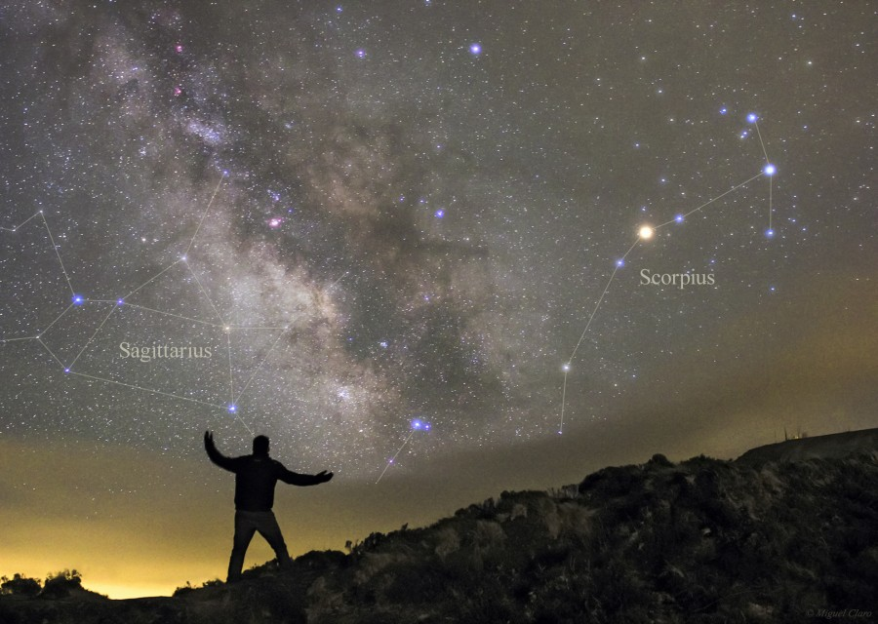
Famous Celestial Objects
- Moon phases and craters
- Planets like Mars, Jupiter, Saturn
- Orion, Ursa Major, Polaris
- Milky Way Galaxy

Slide 7
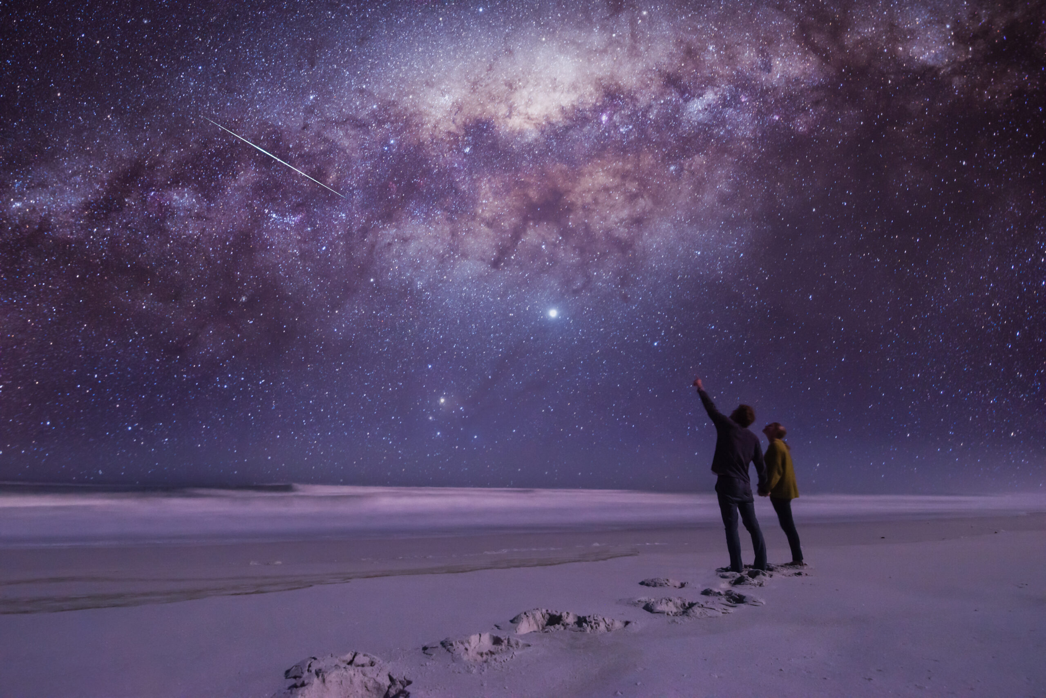
Best Time for Sky Gazing
- Clear and dark nights
- New Moon nights
- Winter sky offers best visibility

Slide 8

THANK YOU
Team member
Kumar Shubham (24SCSE1010890)
Aditya Raj Singh (24sese1011260)
Ankit Raj (24scse1010306)

